Slide 1
ITP171 IT Fundamentals and PROJECT
HARDWARE

Slide 2
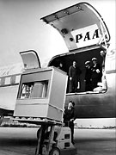
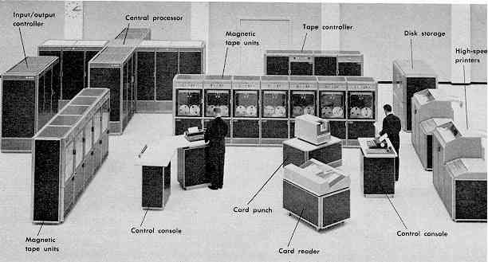
Computer Hardware

Slide 3
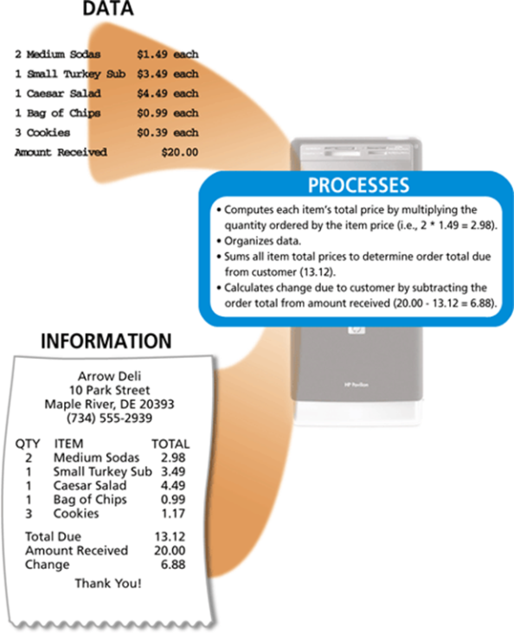
What Is a Computer?
A computer is an electronic device, operating under the control of instructions stored in its own memory
Collects data (input)
Processing
Produces information (output)
Information Processing Cycle

Slide 4
The Components of a Computer
A computer contains many electric, electronic, and mechanical components known as hardware
Input Device
Output Device
System Unit
Storage Device
Communications Device
Allows you to enter data and instructions into a computer
Hardware component that conveys information to one or more people
Case that contains the electronic components of the computer that are used to process data
Records (writes) and/or retrieves (reads) items to and from storage media
Enables a computer to send and receive data, instructions, and information to and from one or more computers or mobile devices

Slide 5
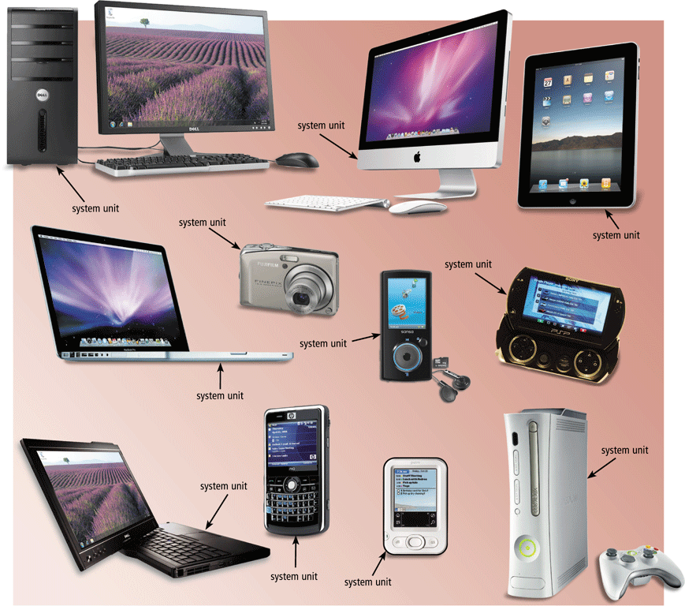
The System Unit
The system unit is a case that contains electronic components of the computer used to process data

Slide 6
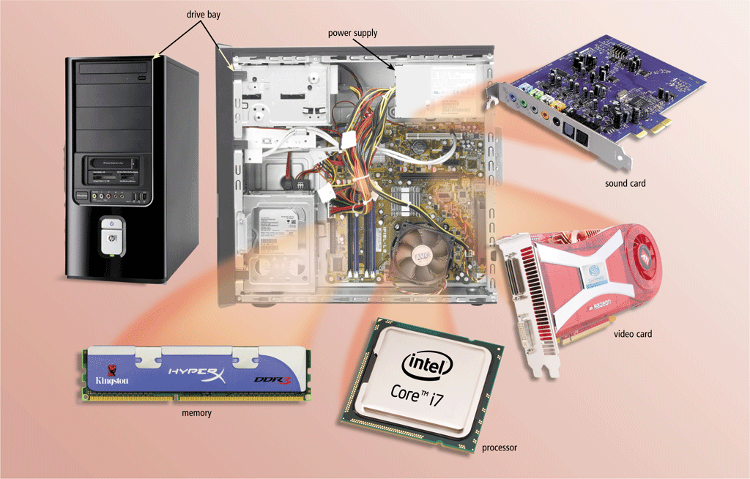
The System Unit
The inside of the system unit on a desktop personal computer includes:
Drive bay(s)
Power supply
Sound card
Video card
Processor
Memory

Slide 7
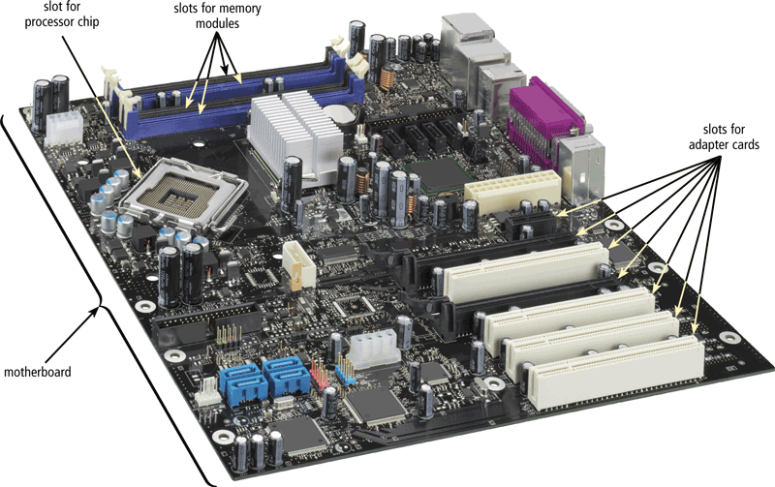
The System Unit
The motherboard is the main circuit board of the system unit
A computer chip contains integrated circuits

Slide 8
Processor
The processor, also called the central processing unit (CPU), interprets and carries out the basic instructions that operate a computer
Contain a control unit and an arithmetic logic unit (ALU)
Multi-core processor
Dual-core processor
Quad-core processor

Slide 9
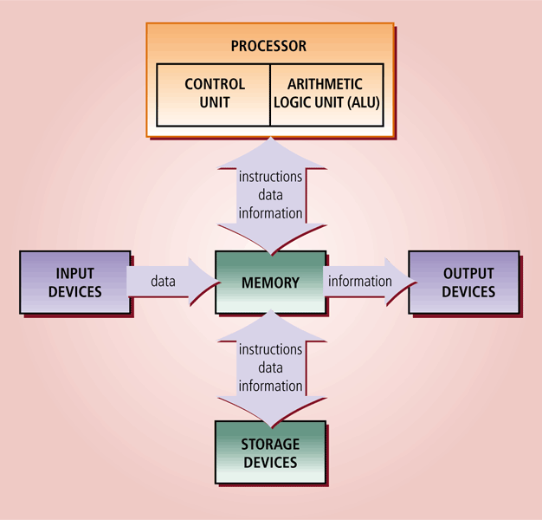
Processor
Multi-core processor
Multi-core processor
is a single computing component with two or more independent actual processing units (called "cores"), which are units that read and execute program instructions.

Slide 10
Processor
The control unit is the component of the processor that directs and coordinates most of the operations in the computer
The arithmetic logic unit (ALU) performs arithmetic, comparison, and other operations

Slide 11
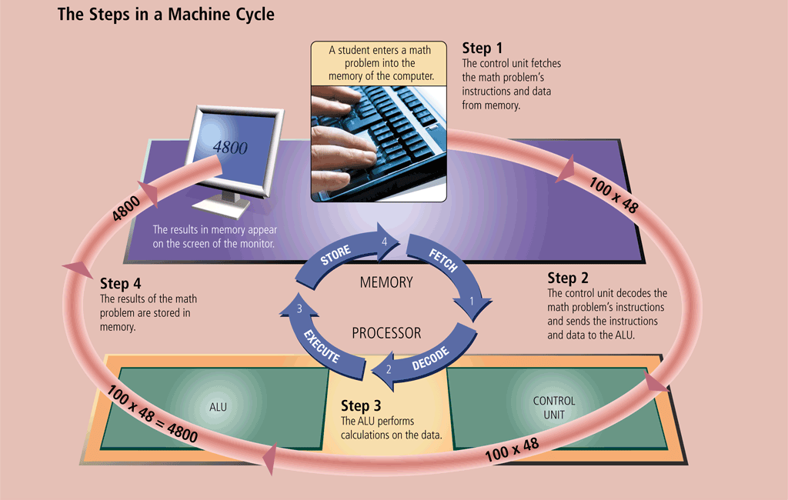
Processor
For every instruction, a processor repeats a set of four basic operations, which comprise a machine cycle

Slide 12
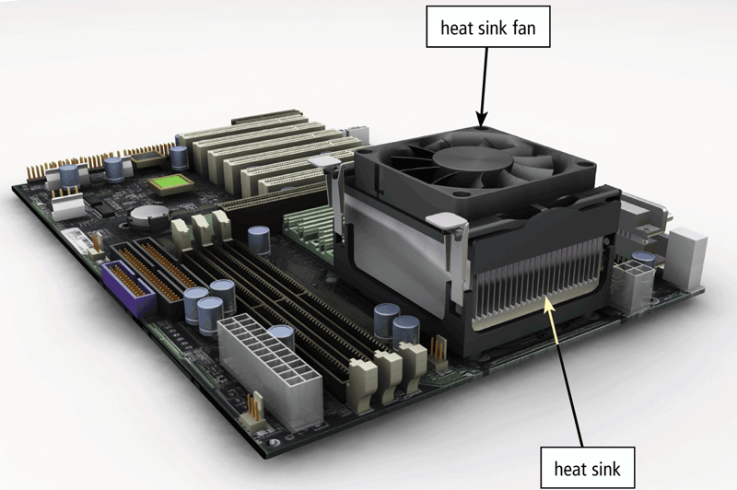
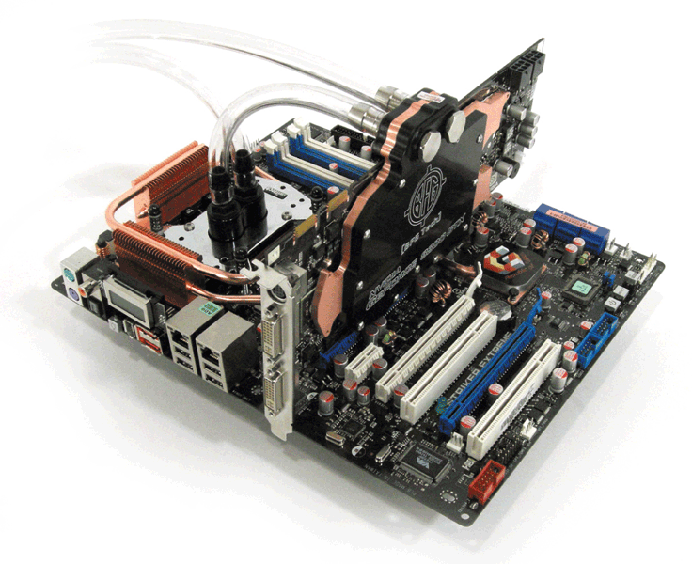
Processor
A processor chip generates heat that could cause the chip to burn up
Require additional cooling
Heat sinks
Liquid cooling technology

Slide 13
Data Representation
Analog signals are continuous and vary in strength and quality
Digital signals are in one of two states: on or off
Most computers are digital
The binary system uses two unique digits (0 and 1)
Bits and bytes

Slide 14
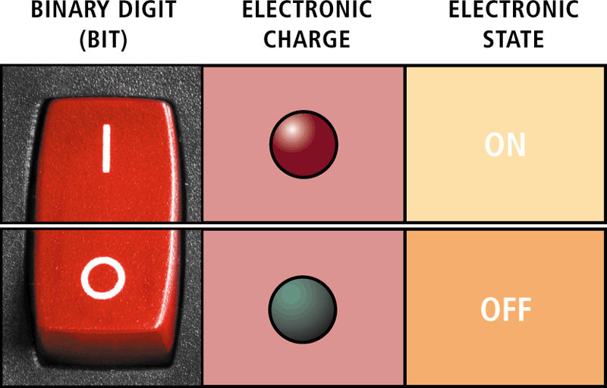
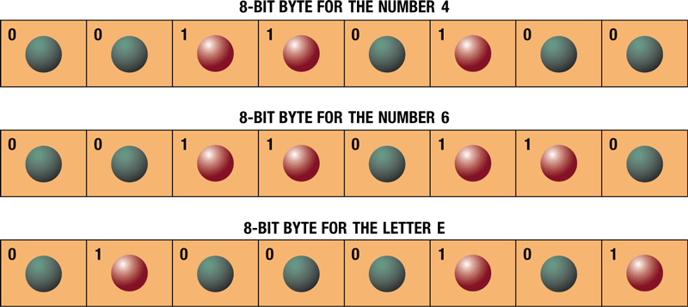
Data Representation
A computer circuit represents the 0 or the 1 electronically by the presence or absence of an electrical charge
Eight bits grouped together as a unit are called a byte. A byte represents a single character in the computer

Slide 15
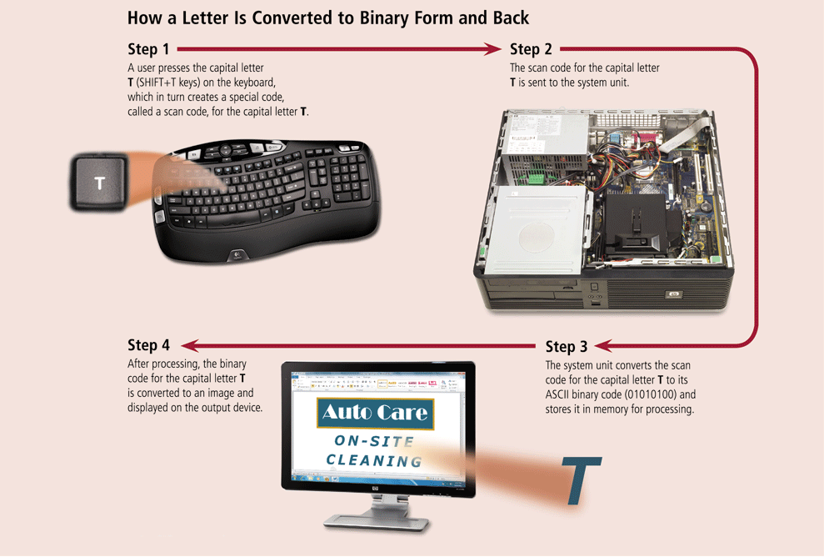
Data Representation

Slide 16
Memory
Memory consists of electronic components that store instructions waiting to be executed by the processor, data needed by those instructions, and the results of processing the data
Stores three basic categories of items:
The operating system and other system software
Application programs
Data being processed and the resulting information

Slide 17
Memory
The system unit contains two types of memory:
Volatile memory
Nonvolatile memory
Loses its contents when power is turned off
Does not lose contents when power is removed
Example includes RAM
Examples include ROM, flash memory, and CMOS

Slide 18
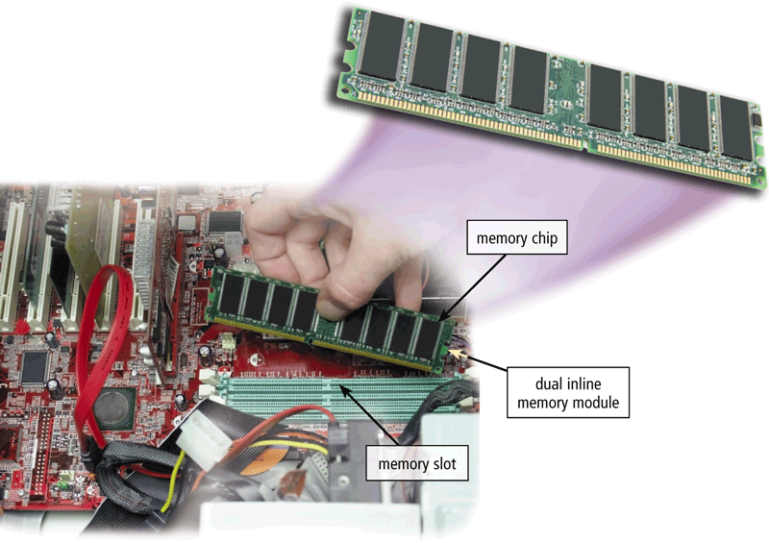
Memory
RAM chips usually reside on a memory module and are inserted into memory slots

Slide 19
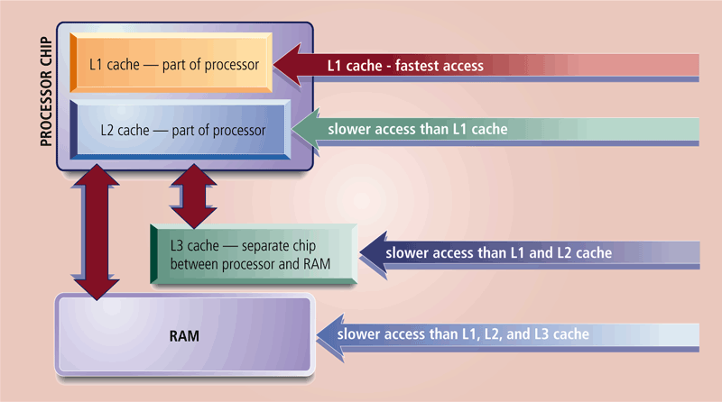
Memory
Memory cache speeds the processes of the computer because it stores frequently used instructions and data

Slide 20
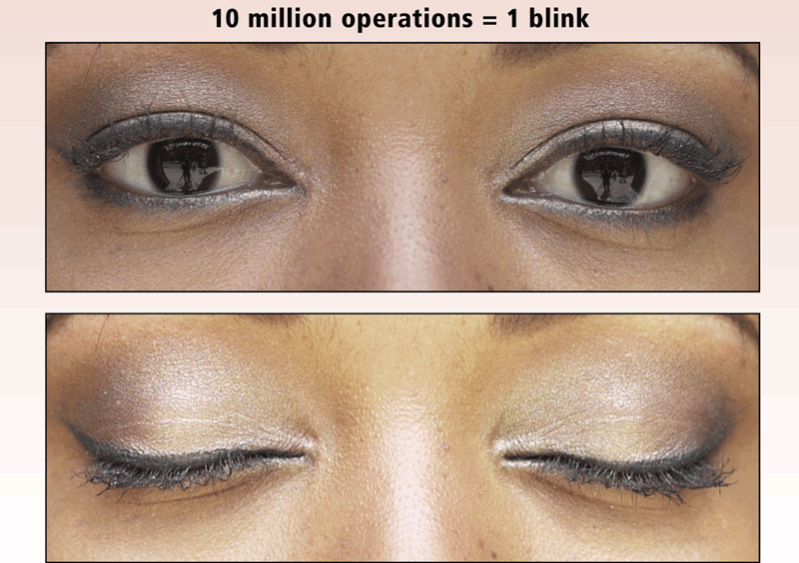
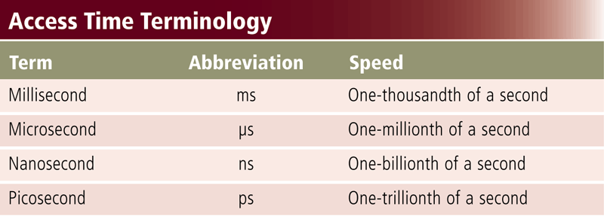
Memory
Access time is the amount of time it takes the processor to read from memory
Measured in nanoseconds

Slide 21
Storage
Storage holds data, instructions, and information for future use
A storage medium is the physical material on which a computer keeps data, instructions, and information

Slide 22
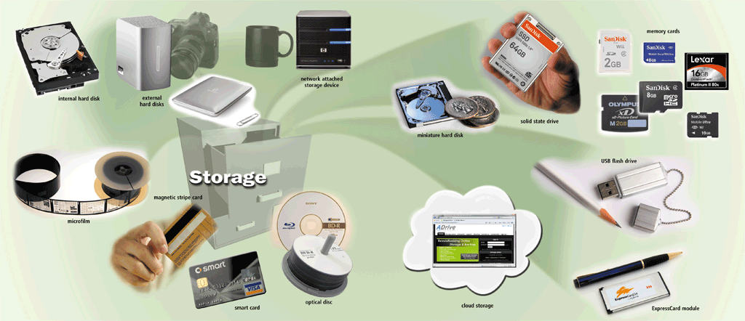
Storage

Slide 23
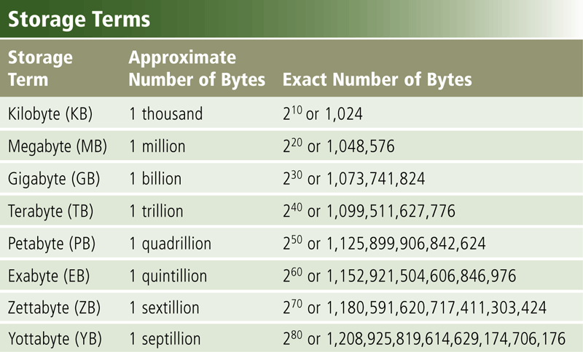
Storage
Capacity is the number of bytes a storage medium can hold

Slide 24
Storage
A storage device is the computer hardware that records and/or retrieves items to and from storage media
Reading is the process of transferring items from a storage medium into memory
Writing is the process of transferring items from memory to a storage medium

Slide 25
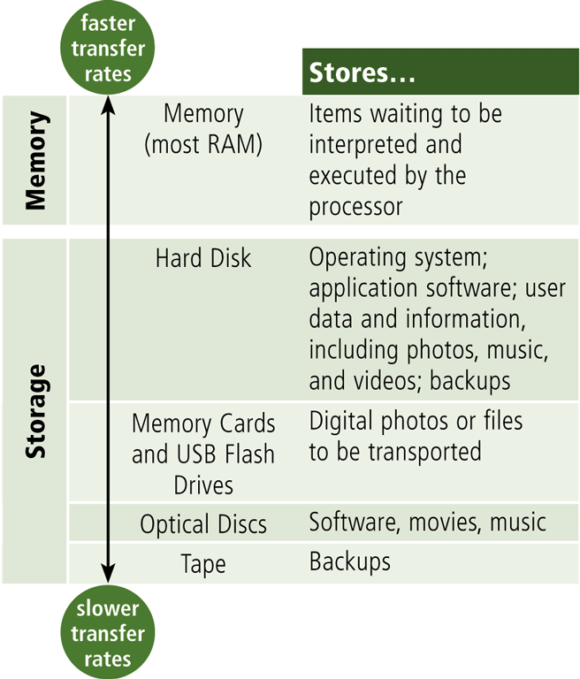
Storage
Access time measures:
The amount of time it takes a storage device to locate an item on a storage medium
The time required to deliver an item from memory to the processor

Slide 26
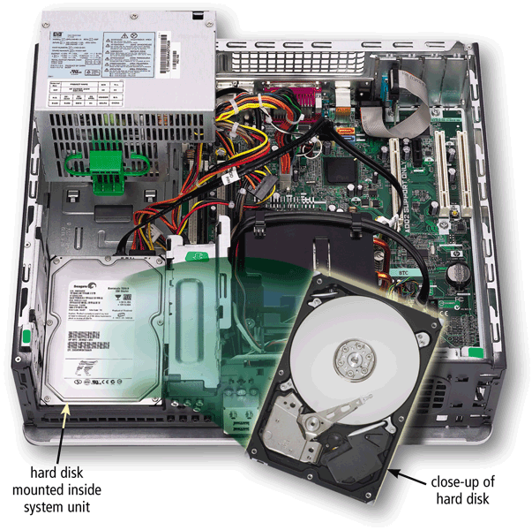
Hard Disks
A hard disk contains one or more inflexible, circular platters that use magnetic particles to store data, instructions, and information

Slide 27
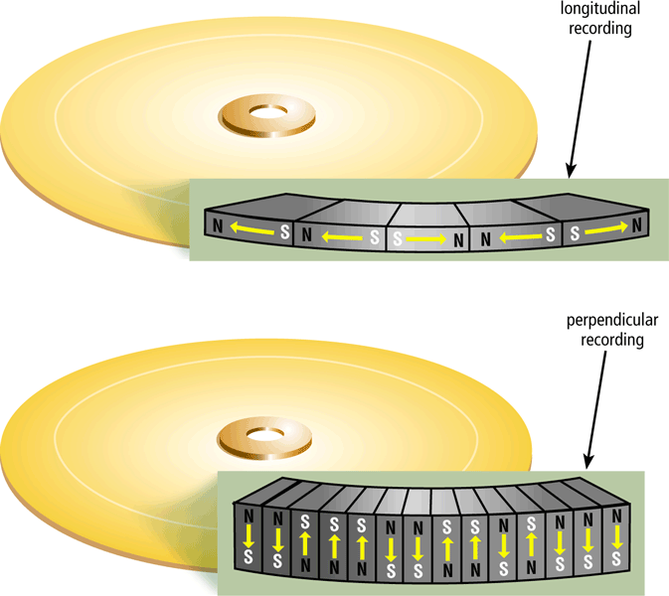
Hard Disks
Hard disks can store data using longitudinal recording or perpendicular recording
Page 356
Figure 7-6

Slide 28
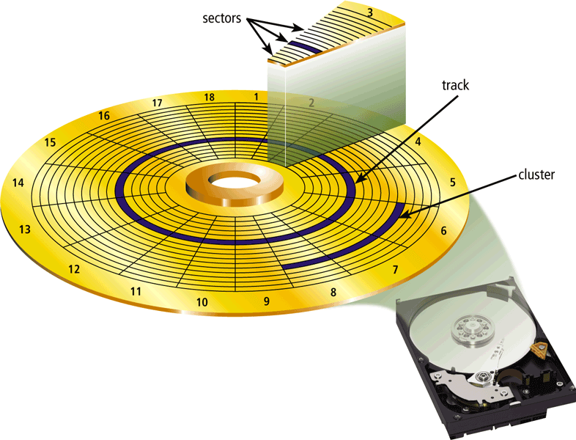
Hard Disks
Characteristics of a hard disk include:
Capacity
Platters
Read/Write Heads
Cylinders
Sectors and Tracks
Revolutions per Minute
Transfer Rate
Access Time
Page 357
Figure 7-8

Slide 29
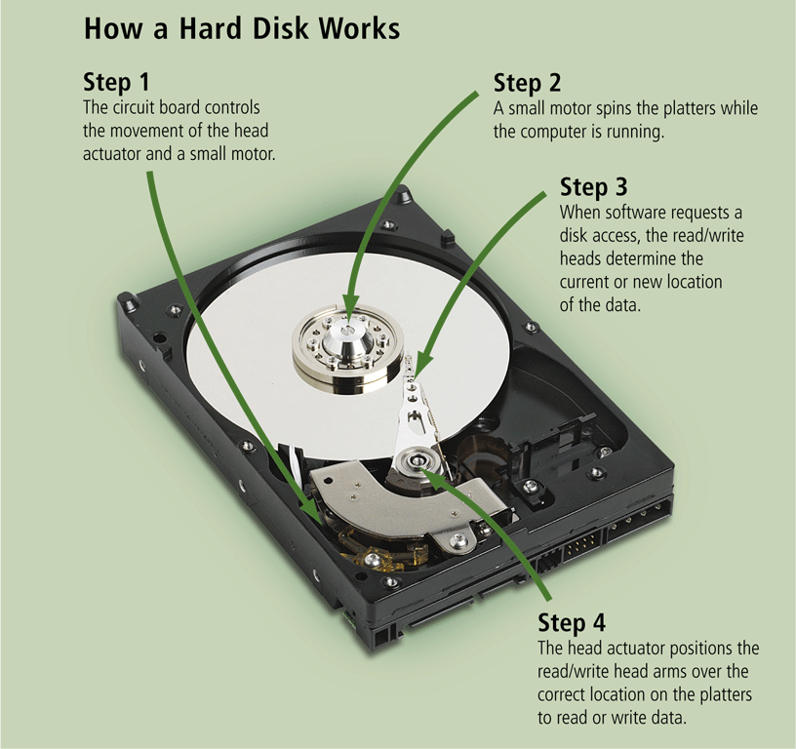
Hard Disks

Slide 30
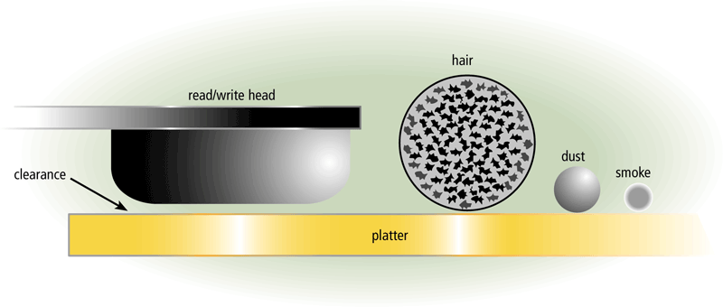
Hard Disks
A head crash occurs when a read/write head touches the surface of a platter
Always keep a backup of your hard disk

Slide 31
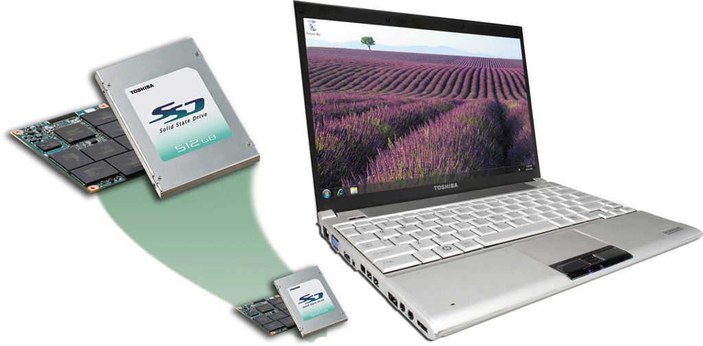
Flash Memory Storage
Flash memory chips are a type of solid state media and contain no moving parts
Solid state drives (SSDs) have
several advantages over
magnetic hard disks:
Faster access time
Faster transfer rates
Generate less heat and consume less power
Last longer

Slide 32
Power Supply
The power supply converts the wall outlet AC power into DC power
Some external peripherals have an AC adapter, which is an external power supply

Slide 33
Conclusion
Just learned one of important pillars of IT which is hardware
You will get to learn different hardware from PC to the expensive toys in the data centre

